Slide 1
Lab 3: Data Visualization
Ying shen
School of software engineering
tongji university

Slide 2
Tasks in data visualization
Task Categories | Task Types
Data and view specification | Visualize data by choosing visual encodings Filter out data to focus on relevant items Sort items to expose patterns Derive values of models from source data
View manipulation | Select items to highlight, filter, or manipulate Navigate to examine high-level patterns and low level detail Coordinate views for linked exploration Organize multiple windows and workspaces
Process and provenance | Record analysis histories for revisitation, review, and sharing Annotate patterns to document findings Share views and annotations to enable collaboration Guide users through analysis tasks or stories

Slide 3
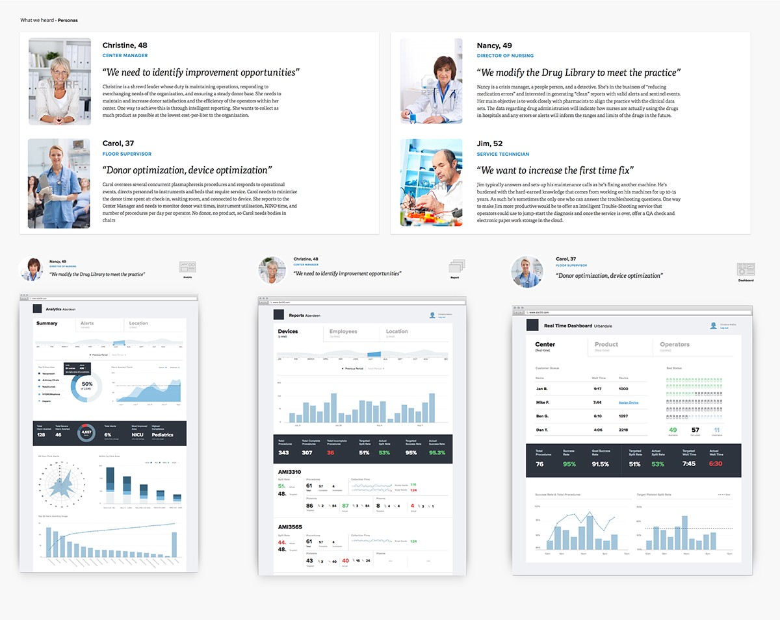
Designing data-driven interfaces
Different users, different data
Notes:
https://blog.truthlabs.com/designing-data-driven-interfaces-a75d62997631
http://www.woshipm.com/data-analysis/691262.html

Slide 4
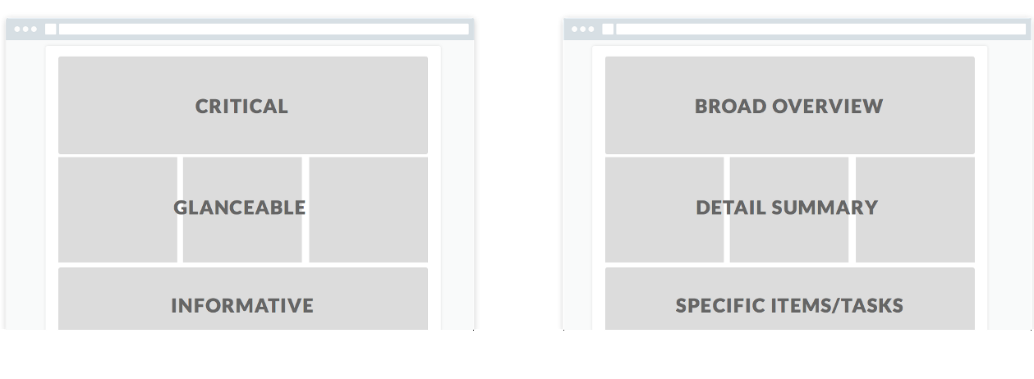
Designing data-driven interfaces
Shape the Page
Show the user what they need to see first, then structure the remainder of the page based on the user story or hierarchy of information.

Slide 5
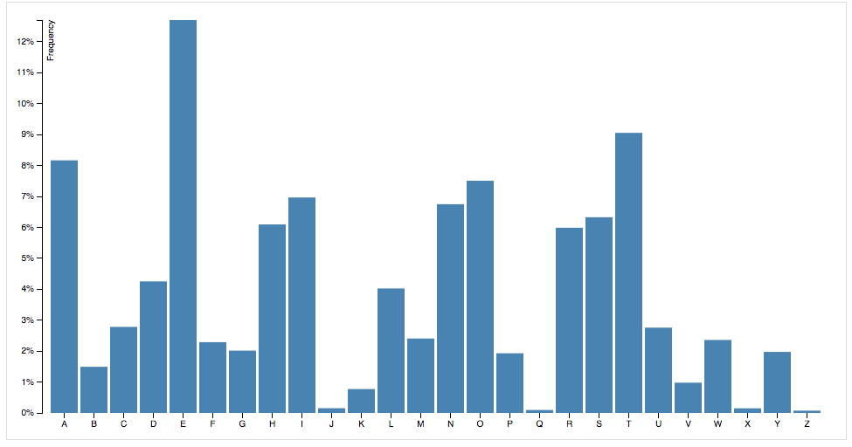
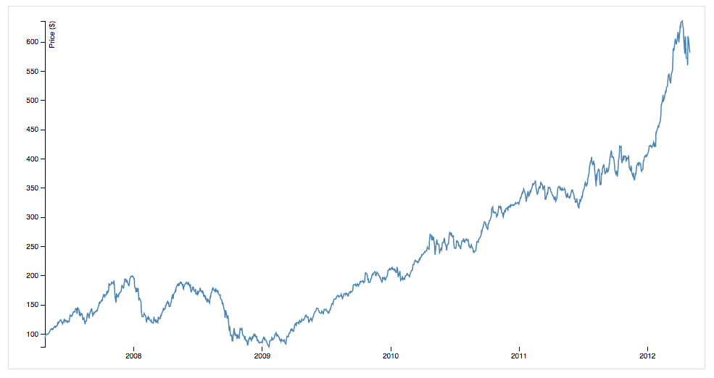
Designing data-driven interfaces
Choose the “right” visualizations
Start with the Data
Working with Discrete vs. Continuous Data
离散的数据
连续的数据

Slide 6
Dashboard examples
Notes:
http://c.raqsoft.com.cn/article/1535420833071?r=gxy

Slide 7
Dashboard examples

Slide 8
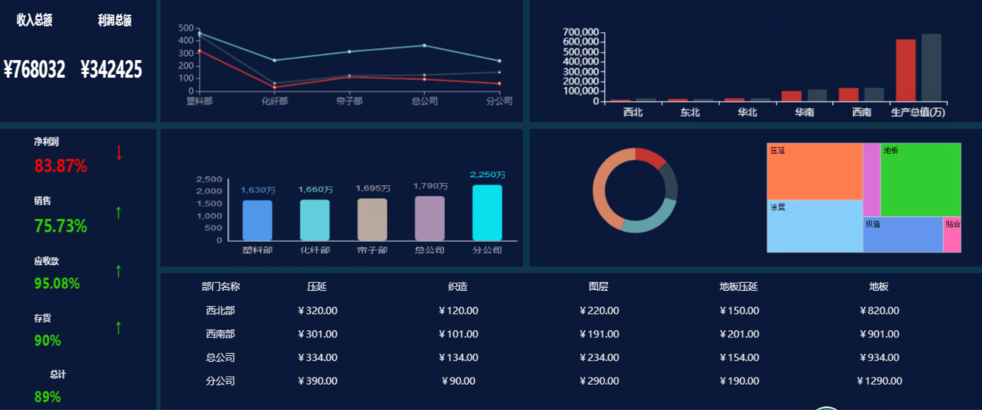
Dashboard examples

Slide 9
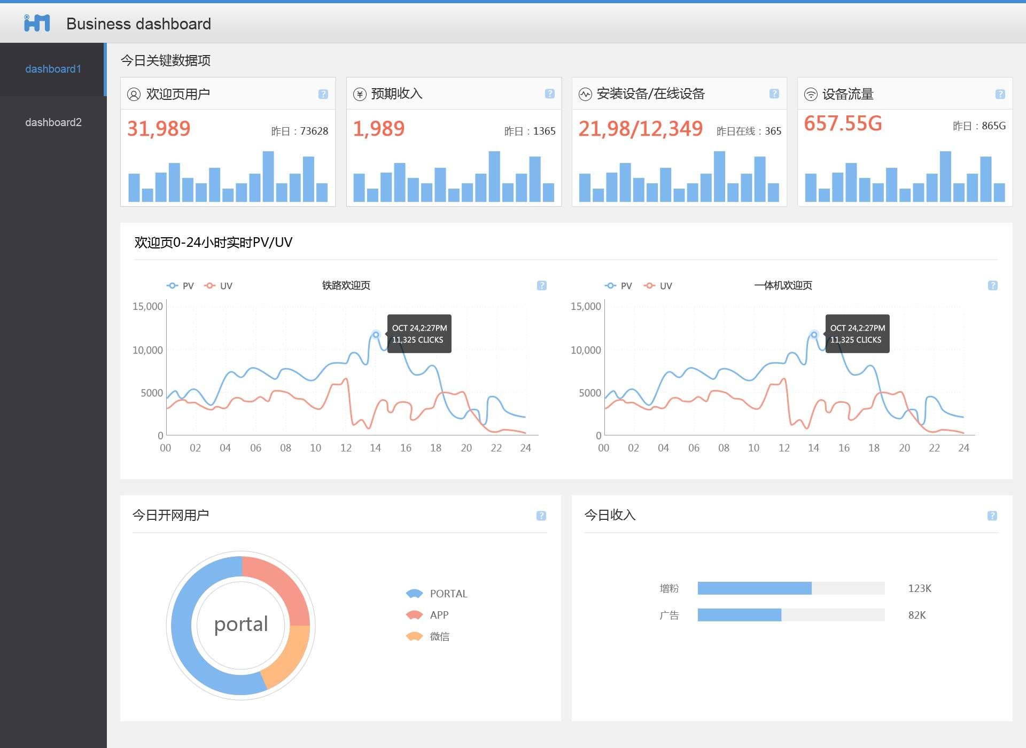
Dashboard examples

Slide 10
Dash in Python
Tutorial: https://dash.plot.ly/
Examples and source codes: https://dash.plot.ly/gallery

Slide 11
Dataset 1: Black Friday
Description
The dataset here is a sample of the transactions made in a retail store. The store wants to know better the customer purchase behavior against different products. Specifically, here the problem is a regression problem where we are trying to predict the dependent variable (the amount of purchase) with the help of the information contained in the other variables.
Classification problem can also be settled in this dataset since several variables are categorical, and some other approaches could be "Predicting the age of the consumer" or even "Predict the category of goods bought". This dataset is also particularly convenient for clustering and maybe find different clusters of consumers within it.
Notes:
https://www.kaggle.com/mehdidag/black-friday

Slide 12
Dataset 2: Google Play Store Apps
Content
Each app (row) has values for category, rating, size, and more.
Inspiration
The Play Store apps data has enormous potential to drive app-making businesses to success. Actionable insights can be drawn for developers to work on and capture the Android market!
Notes:
https://www.kaggle.com/lava18/google-play-store-apps

Slide 13
Dataset 3: College Salaries
Salary Increase By Type of College
Salaries By Region
Salary Increase By Major
All data was obtained from the Wall Street Journal based on data from Payscale, Inc
Notes:
https://www.kaggle.com/wsj/college-salaries

Slide 14
Install packages
pandas
dash
plotly

Slide 15
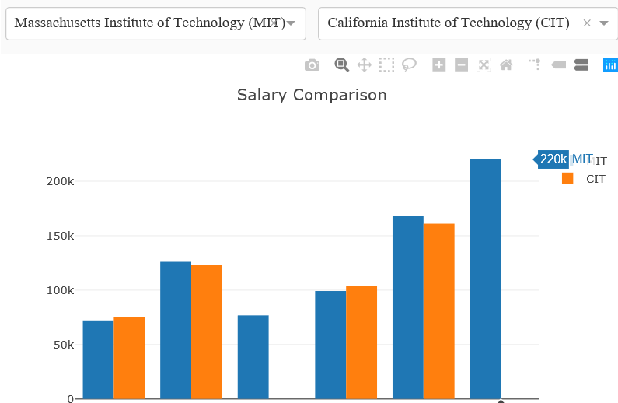
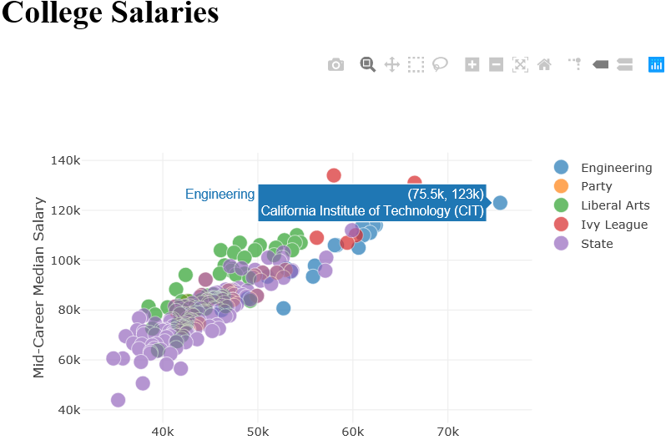
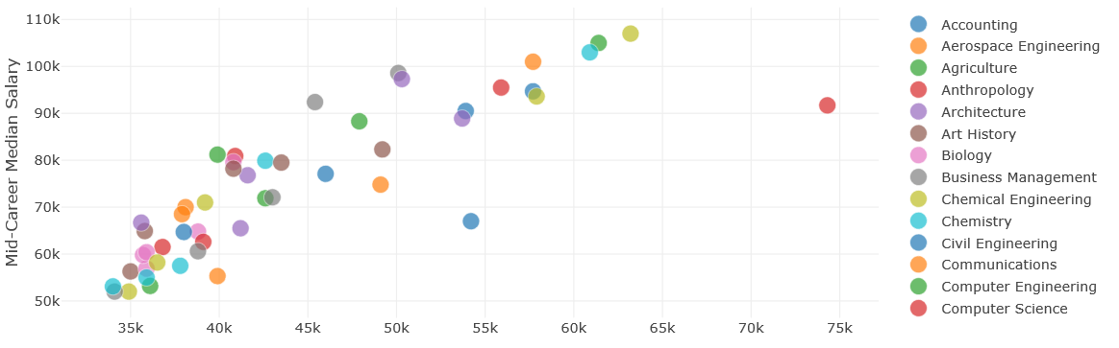
Assignment
Design and implement a Dashboard for one of three datasets
The dashboard should contain at least three graphs (e.g. scatter plot, bar chart, pie chart, line chart, etc) which reveal certain information respectively
It’s not necessary to visualize all the columns/rows of the dataset. You can choose only several of them.
An example

Slide 16
Report
The report should contains the following contents (in English, 2~3 pages):
Describe a data analysis task for the chosen dataset (objectives, characteristics of the dataset, etc);
Describe the layout of designed dashboard and briefly describe the patterns revealed in the figures.
Submit your work (code and report)
Prepare a readme file to illustrate how to run your program
Compress the codes and the report into a zip file: ID_name_lab3.zip
Email address: hcitjsse@163.com

